Slide 1
Overview - Equity, Diversity & Inclusion Survey October 2020 (survey conducted March 2020)
Monica Kay, Director-Diversity, Equity & Human Rights Office
Sean De Maio, EDI Policy Analyst
Dr. Tehmina Khwaja, EDI Post-doctoral Fellow

Slide 2
Purpose of Survey
To “take the pulse” of all members of the VIU community, by soliciting feedback on perspectives and feelings regarding diversity and inclusion
Understand the extent to which employees and students feel genuinely included
Identify opportunities for creating a more inclusive, diverse and equitable environment at all VIU campuses
Incorporate the findings from both the survey and subsequent dialogue to develop and implement the VIU Equity, Diversity and Inclusion Action Plan

Slide 3
VIU Equity Diversity Inclusion: Environmental Scan Results
“Designated Groups”:
-- Living with a Disability -- Women (Gender)
-- Racialized/Persons of Colour/”Visible Minority” -- Indigenous Community Members
-- LGBTQ2S+
Demographics
Respondents by campus
Respondents by Designated Group
Respondents by gender and LGBTQ2S+ identities
Age ranges – employees and students
Income levels – employees and students
Snapshots of inclusion
Overview of feelings of inclusion
Selected associations

Slide 4
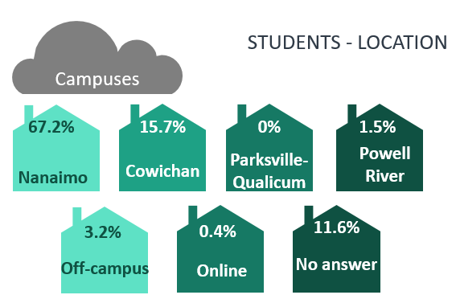
Respondents by campus

Slide 6
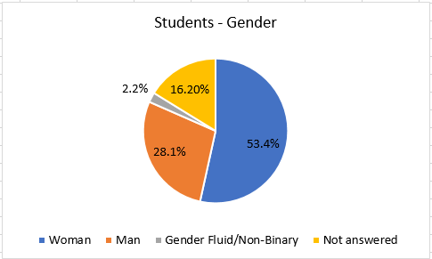
Respondents by gender

Slide 7
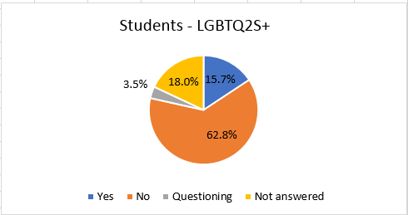
LGBTQ2S+ respondents

Slide 8
Sample 4
Survey Response Totals, by Designated Group
(March 2020)
Employees
Students
624 Employees responded to the survey, which represents 34% of all employees at VIU as of March 2020
1391Students responded to the survey, which represents12% of all students at VIU as of March 2020
Women
391 (61.2%)
(53.4%) 743
Women
Visible Minority
43 (6.7%)
(16.0%) 222
Living with Disability
Living with Disability
42 (6.6%)
(15.7%) 219
LGBTQ2S+
LGBTQ2S+
40 (6.3%)
(12.4%) 173
Visible Minority
Indigenous
34 (5.3%)
( 10.6%) 147
Indigenous
NOTE: This data only represents those respondents who identified with one or more designated groups

